Slide 1
Problem Solving using Coding!

Slide 2


Join at slido.com #1874945
ⓘ Start presenting to display the joining instructions on this slide.

Slide 3
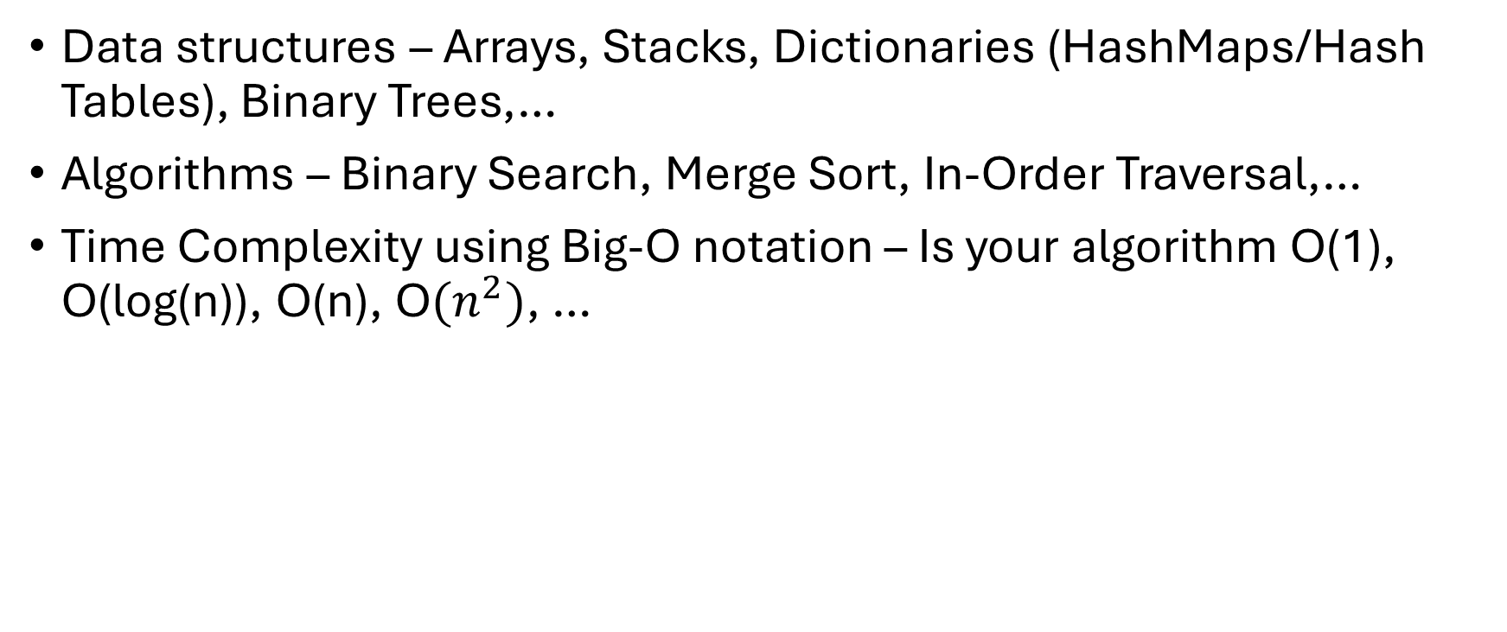
Key Points to consider…
Data structures – Arrays, Stacks, Dictionaries (HashMaps/Hash Tables), Binary Trees,…
Algorithms – Binary Search, Merge Sort, In-Order Traversal,…
Time Complexity using Big-O notation – Is your algorithm O(1), O(log(n)), O(n), O${(n}^{2})$, …

Slide 4
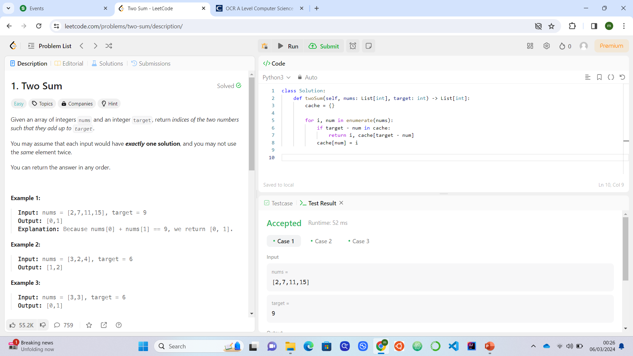
The Problem – Two Sum

Slide 5
Examples…

Slide 6
Initial Ideas?

Slide 7
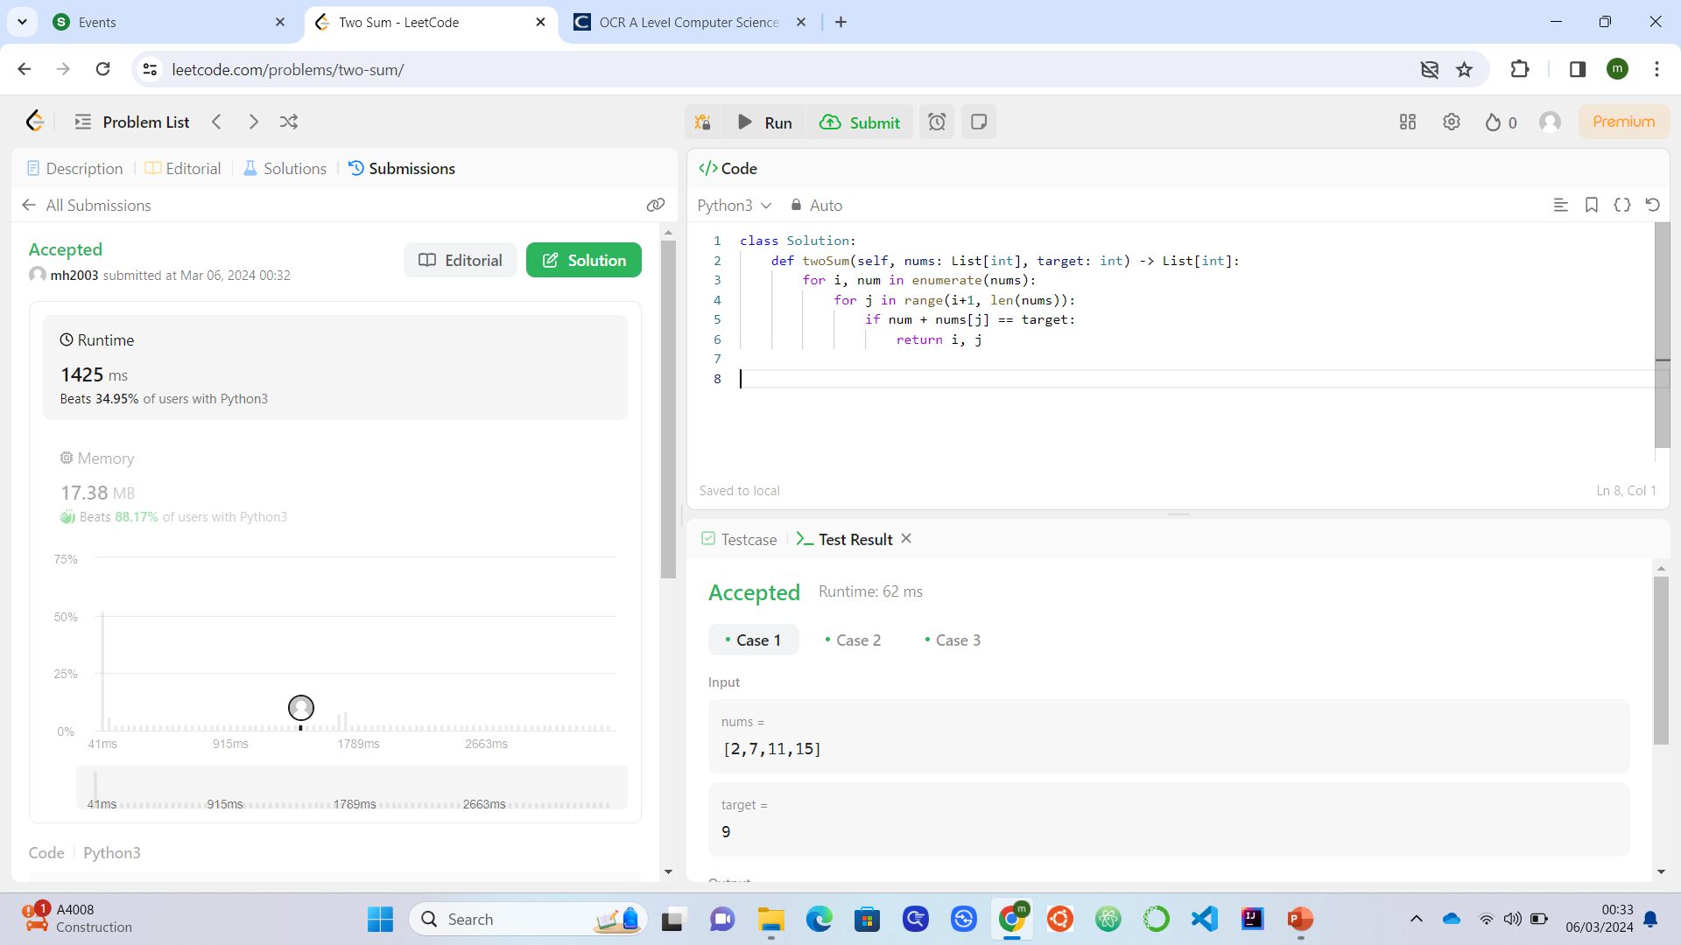
Solution #1
How does this solution work? Talk through the logic.
What is the big-O time complexity of this solution?
Is this the perfect solution? Can we improve on it? If so, how?

Slide 8
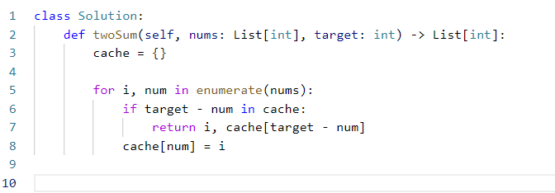
Solution #2
How does this solution work? Talk through it.
What data structure is being used in this solution? How and why is it helpful to us?
Why is this solution better?
What is the time complexity of this solution?

Slide 9
Key Points to take away from this
Always see if we are doing any redundant work
Always check if there are other possible approaches to make a solution more efficient
Hashmaps/dictionaries are often very useful if we are looking for an efficient algorithm since they have O(1) (constant) access time for any element in it.
Extra: Can you explain how a hashmap/dictionary is built and works internally?

